Slide 1
Introduction to Metagenomics
Kirsten mclay
Platform and Pipelines Operations Manager

Slide 2
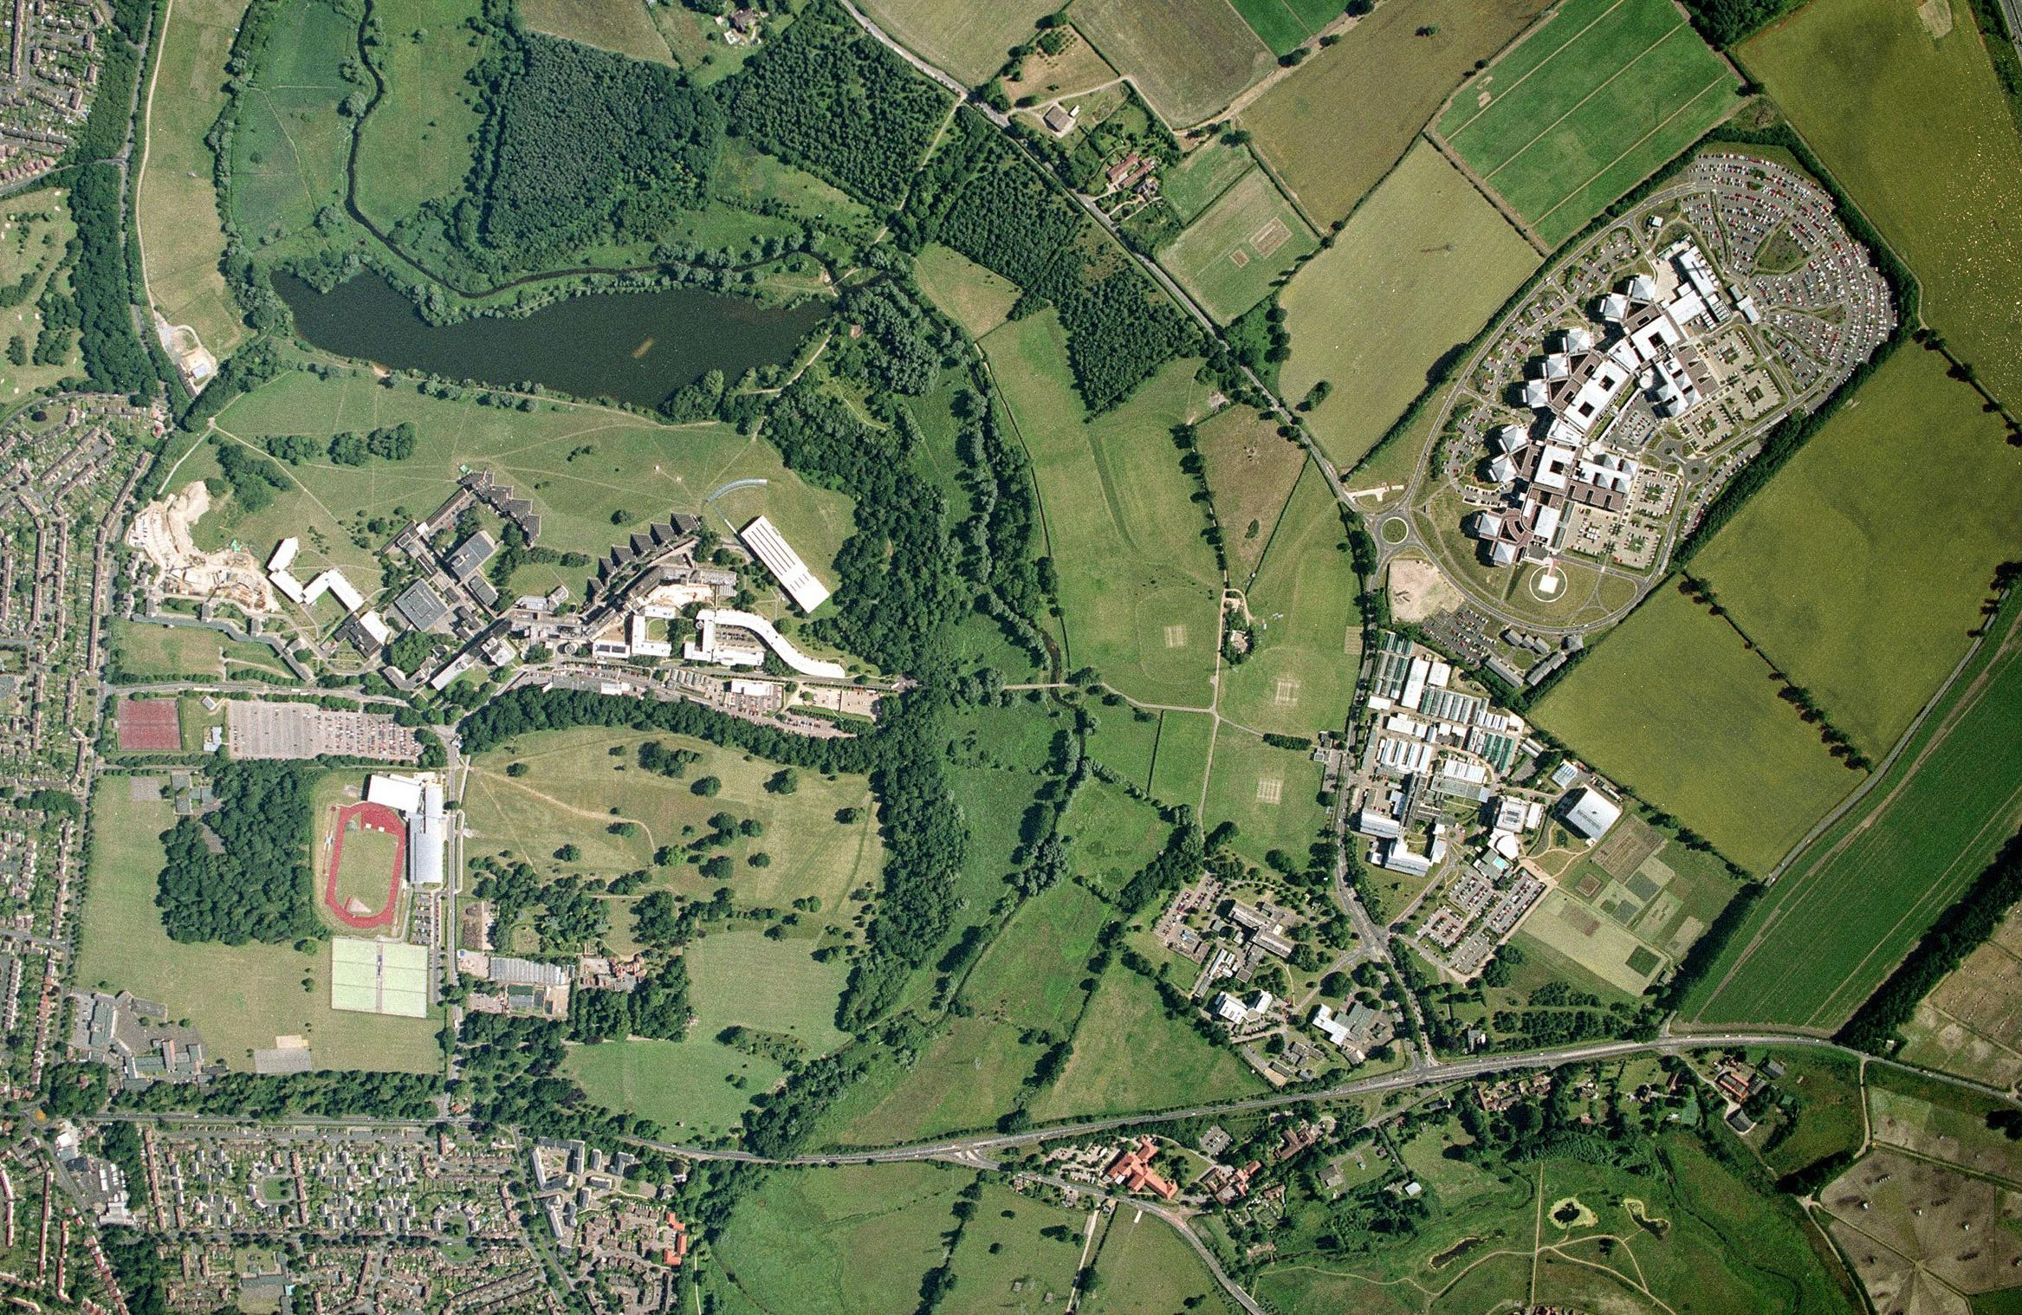
Norwich Research Park
Norfolk and Norwich
University Hospital
SampleQC
University of East Anglia
John Innes
Centre
Earlham Institute
Application
Portfolio
Sainsbury
Laboratory
Institute of Food Research

Slide 3


About Us
Earlham Institute (formerly The Genome Analysis Centre) opened in July 2009, we are a UK National Capability for genomic research
Multi-disciplinary expertise in living systems
Utilise computational science and biotechnology to answer ambitious biological questions and generate enabling resources
Combine cutting-edge technologies to deliver the next frontier in scientific research
Application of genomics and bioinformatics to advance bioscience research and innovation
Partner with industry, share our knowledge, develop new intellectual property and create new technologies
Sequencing
Genome research and analysis
‘Big data’ tools and Bioinformatics resources
High performance computing
Super computers
>20TB memory & 1000’s + cores
Technology development
Outreach and training

Slide 4
Introduction to Metagenomics

Slide 5
What is the metagenome?
metagenome:
the genomes of all the microorganisms of an environmental sample
often studied using culture independent techniques
“metagenomics”
Handelsman, J.; Rondon, M. R.; Brady, S. F.; Clardy, J.; Goodman, R. M. (1998). "Molecular biological access to the chemistry of unknown soil microbes: A new frontier for natural products". Chemistry & Biology 5 (10): 245–249.

Slide 6
What is the metagenome?
Only a small percentage of the microorganisms can be cultured (around 1%) (Pace et al., 1985)
Soil microbial communities could contain between 5,000 and 20,000 different species, but only few can be isolated and cultured (~50-200)
The study of the metagenome provides culture independent information about the microorganisms of an environmental sample

Slide 7

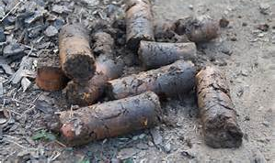
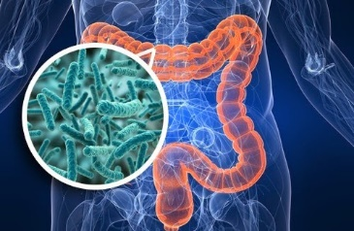
Environmental Metagenomics
Environmental metagenomics is the study of organisms in a microbial community based on analysing the DNA within an environmental sample
- profiling microbial populations
- water samples taken from deep ocean vents
- soil samples
- human-made environments like active mineral mines
Environmental metagenomics study data are used for agricultural microbiome analysis, ecological remediation, or other biological investigations
Environmental metagenomics as a field was deemed rather limited prior to the advent of next-generation
sequencing (NGS)
NGS provides researchers the capability to profile entire microbial communities from complex samples,
discover new organisms, and explore the dynamic nature of microbial populations under changing conditions

Slide 8
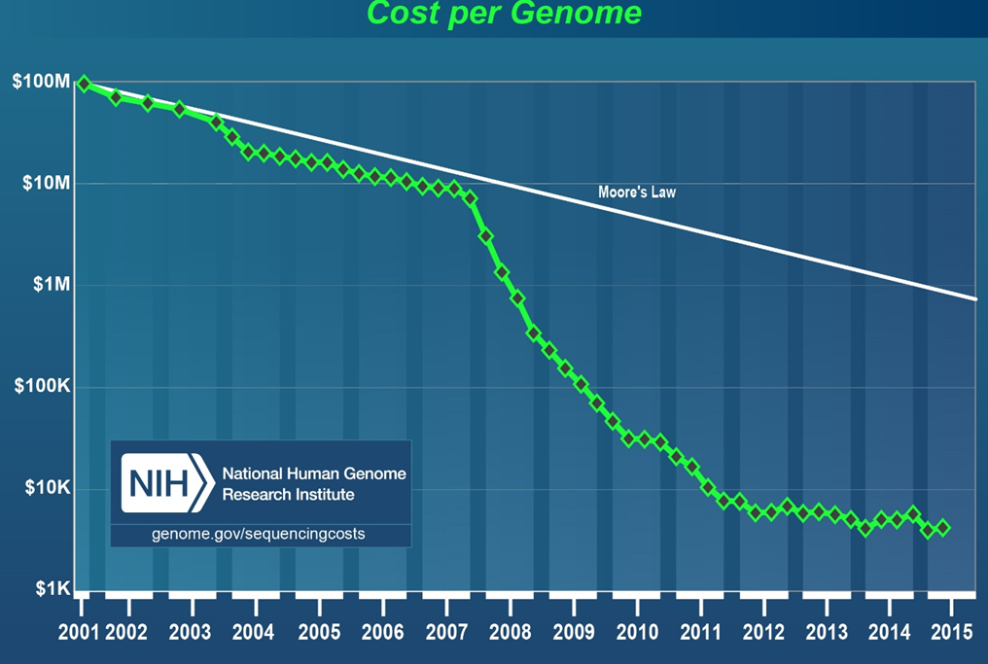
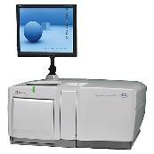
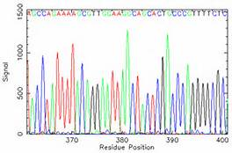
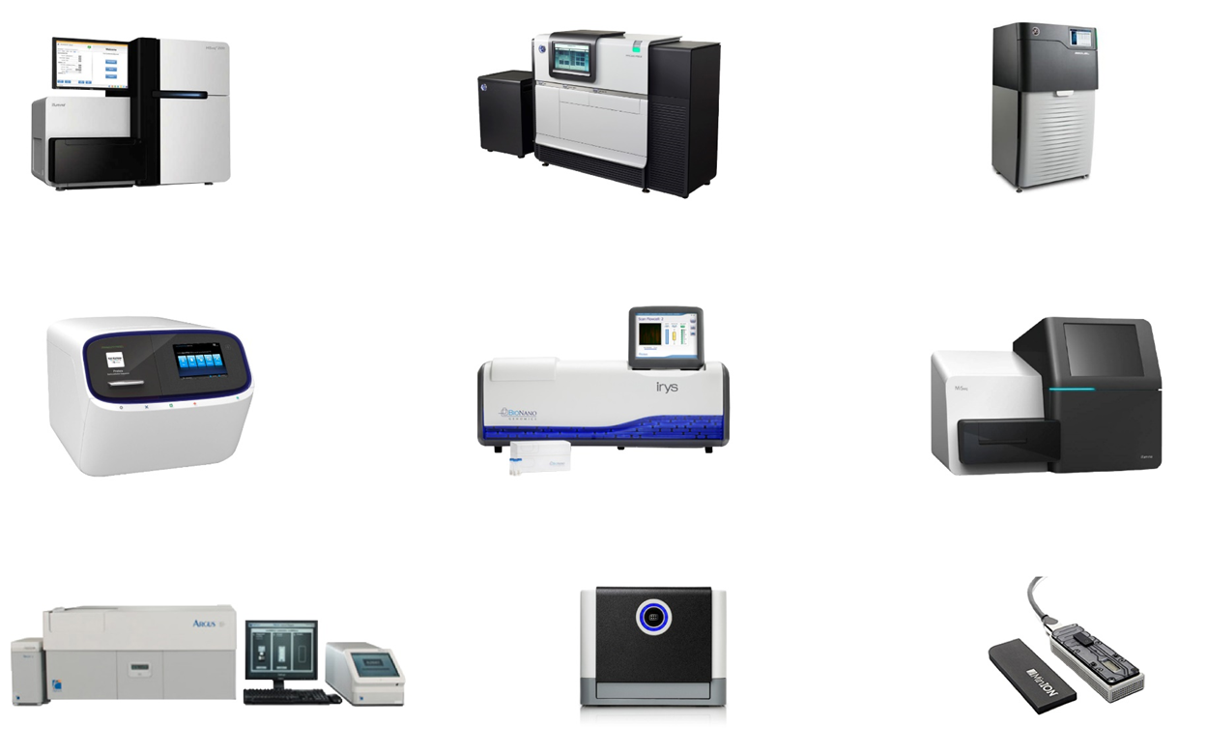
comprehensively sample all genes in all organisms present in a given complex sample
evaluate bacterial diversity and detect the abundance of microbes in various environments
provides a means to study unculturable microorganisms that are otherwise difficult or challenging to analyse
unlike capillary sequencing or PCR-based approaches, next-generation sequencing (NGS) allows researchers to sequence thousands of organisms in parallel
combine many samples in a single sequencing run and obtain high sequence coverage per sample
NGS-based metagenomic sequencing can detect very low abundance members of the microbial community that may be missed or are too expensive to identify using other methods
Notes:
For the last 50 years, Moore’s Law has been almost an absolute constant for measuring progress in technology.

Slide 9
How to study the metagenome?
metaproteomics
metabolomics
culture independent techniques
to study microbial communities
metagenomics
metatranscriptomics
total DNA isolation from the environmental sample
(soil, water, insect guts, human intestine, skin, saliva, etc)
Direct
sequencing
Which microbes are in the sample?
Analysis of microbial diversity
(sequencing of 16S rRNA libraries)
Construction of metagenomic libraries
for functional analysis (host that can be
cultured and genetically manipulated)
Sequencing of
metagenome

Slide 10

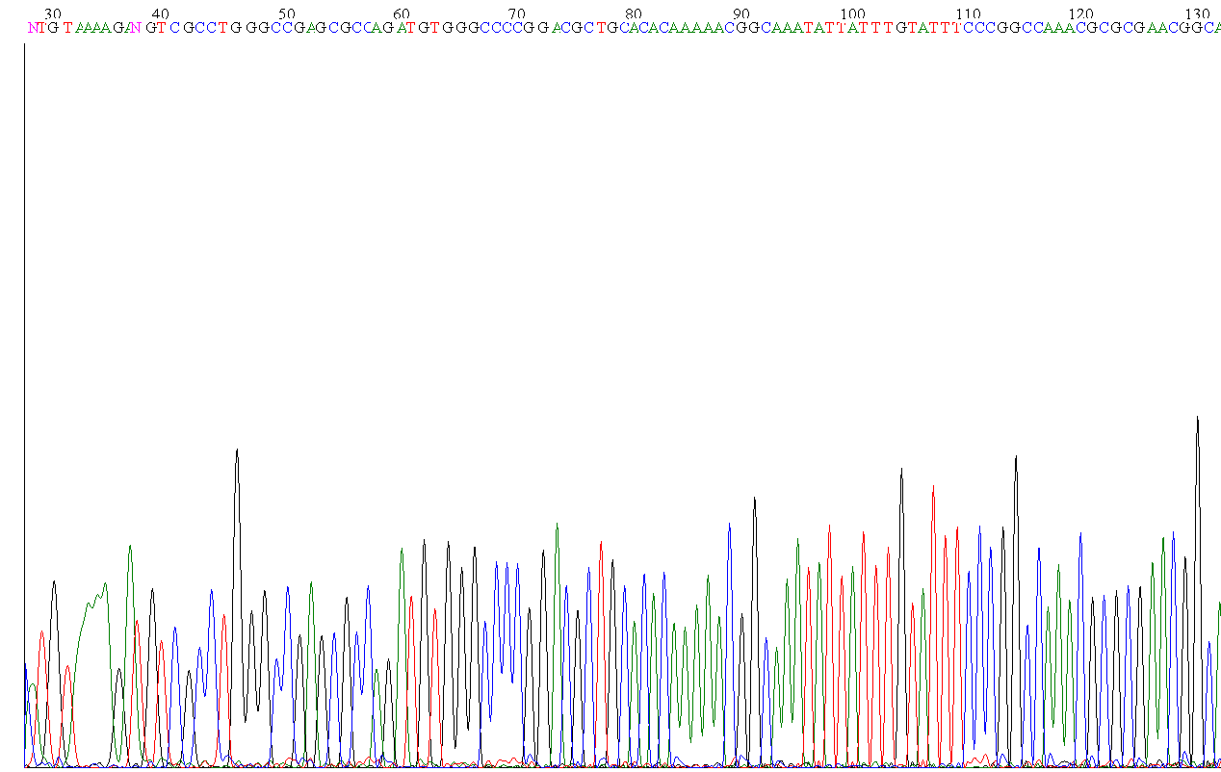
Sequencing of the metagenomic DNA
Environmental sample
A
B
Metagenomic library
Total DNA
Direct sequencing
“shotgun”
(3Kb)
Next generation
Plasmid or fosmid isolation
Roche 454
Ilumina
End sequencing
sequencing
LifeTech Ion Torrent
PacBio (SMRT)
Discard vector seq
DNA assembly in silico
DNA assembly in silico
DNA assembly in silico
Notes:
Mega insert eg Bac sequencing

Slide 11
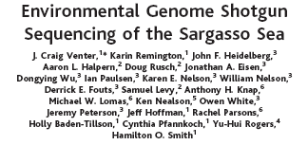

Venter et al, Science 2004
Microorganisms collected from the Sargasso Sea in Bermuda
Metagenomic DNA is fractionated and libraries constructed with 2-6kb inserts
The prepared plasmid clones were sequenced from both ends to provide paired-end reads on an ABI 3730XL DNA sequencer (Applied Biosystems)
A total of 1.045 billion base pairs of non-redundant sequence was generated, annotated, and analysed to elucidate the gene content, diversity, and relative abundance of the organisms within these environmental samples
These data are estimated to derive from at least 1800 genomic species based on sequence relatedness, including 148 previously unknown bacterial phylotypes
have identified over 1.2 million previously unknown genes represented in these samples, including more than 782 new rhodopsin-like photoreceptors. Variation in species present and stoichiometry suggests substantial oceanic microbial diversity

Slide 12
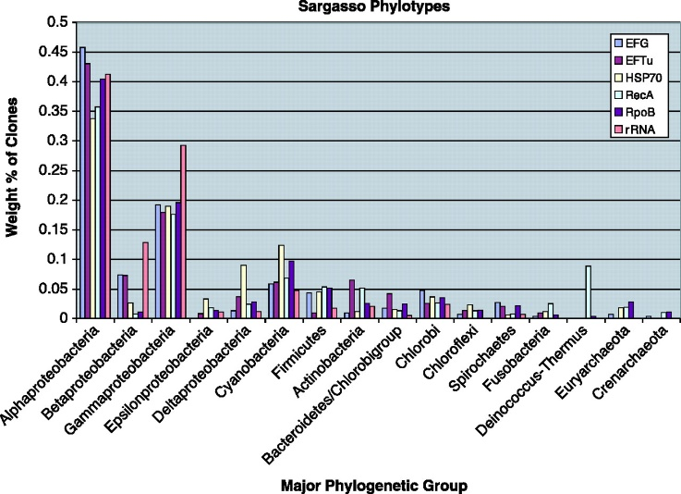
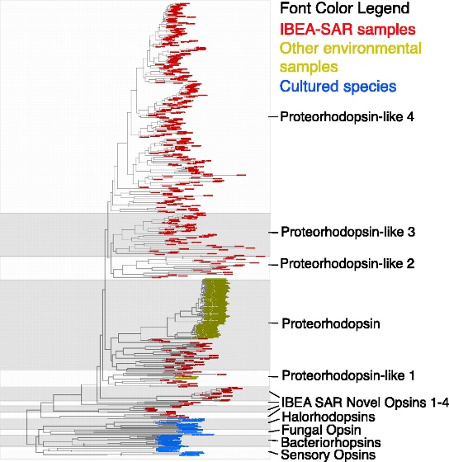
The relative contribution of organisms from different major phylogenetic groups (phylotypes) was measured using multiple phylogenetic markers that have been used previously in phylogenetic studies of prokaryotes
Phylogenetic tree of rhodopsinlike genes in the Sargasso Sea data with all homologs of these genes in GenBank.
The sequences are coloured according to the type of sample in which they were found:
Blue - cultured species
Red - sequences from uncultured species
Yellow - sequences from uncultured organisms in other environmental samples

Slide 13
Construction of metagenomic libraries for functional analysis
Environmental DNA
fragmentation
vector
+
insert
recombinant
vectors
Host: Escherichia coli
Metagenomic library
Functional analysis
Notes:
Physical electroporation or Enzymatic Heat shock

Slide 14
Selecting the appropriate protocol for metagenomic libraries
for functional analysis
a
1. Sample type
Liquid, solid (soil, sediment, etc), faeces
2. DNA/RNA
Extraction method
From raw sample
After matrix/cell separation
Extraction of DNA or DNA/RNA together
3. Vector type
Short insert (phagemid or plasmid)
Large insert (fosmid or cosmid)
Mega-large insert (pBAC)
4. DNA digestion
Enzymatic
Physical
Escherichia coli
Pseudomonas putida
Bacillus subtilis
Streptomyces
Pichia pastoris
5. Microbial host

Slide 15
Construction of metagenomic libraries
Environmental DNA
partial Sau3AI digestion
vector
pBluescript SKII
Bam HI digested
+
insert: 1-10 Kb
recombinant
vectors
Host: Escherichia coli
SCREENING
AMPLIFICATION
Notes:
Transformation is the physical insertion of foreign DNA into a cell, followed by stable expression of proteins. It can be done by chemical, electrical, or biological methods.
The transformed cells are then grown on selective media so that only the cells carrying vectors will survive.

Slide 16
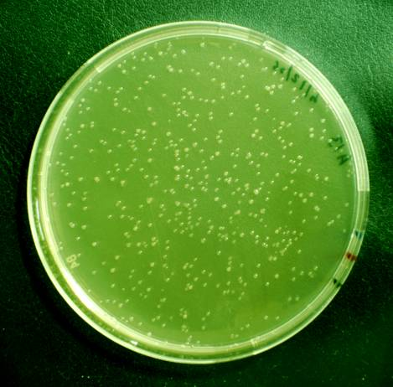
Screening of metagenomic libraries
Pool
Plasmid
DNA isolation
Retransformation
(to discard chromosomal
mutations)
Individual
clones
Confirm resistance
Selection
Digestion
(independent clones)
Identification of the genes involved in the resistance phenotype
Sequence
Annotation
Subcloning
In vitro mutagenesis
transposon
Notes:
The chemical properties of the expressed metagenomic DNA can be examined by performing chemical assay on products created by the model organism.
The sequence of the bases in the DNA can be compared to databases of known DNA to get information regarding the structure and organization of the metagenomic DNA. Comparisons of these sequences can provide insight into how the gene products (proteins) function.

Slide 17
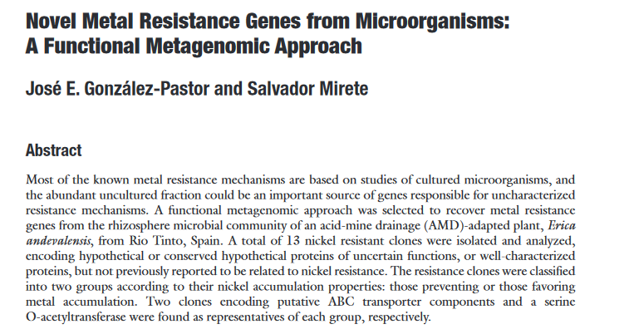
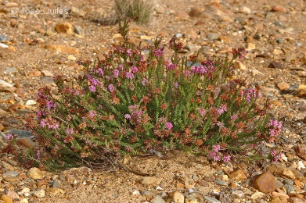
Gonzalez-Pastor & Mirete, Metagenomics, 2010
A functional metagenomic approach was selected to recover metal resistance genes from the rhizosphere microbial community of an acid-mine drainage (AMD)-adapted plant, Erica andevalensis from Rio Tinto, Spain.
13 nickel resistant clones were isolated and analysed, encoding hypothetical or conserved hypothetical proteins of uncertain functions, or well-characterized proteins, but not previously reported to be related to nickel resistance
The resistance clones were classified into two groups according to their nickel accumulation properties: those preventing or those favouring metal accumulation. Two clones encoding putative ABC transporter components and a serine O-acetyltransferase were found as representatives of each group
Notes:
Heather
Microbial DNA used to construct small insert libraries
Direct lysis method to avoid losing novel functional diversity
Most of the metals become toxic if they accumulate above normal physiological concentrations

Slide 18
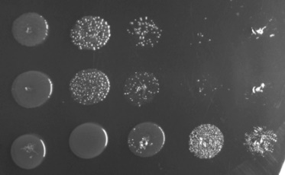
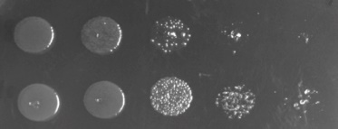
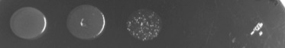

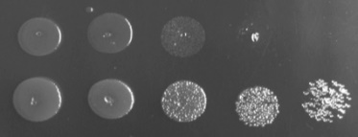
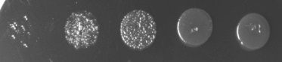
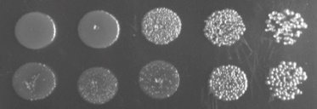
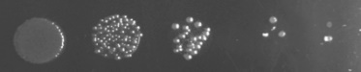
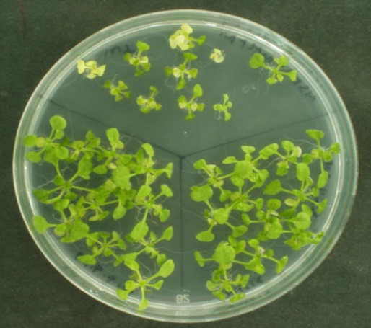
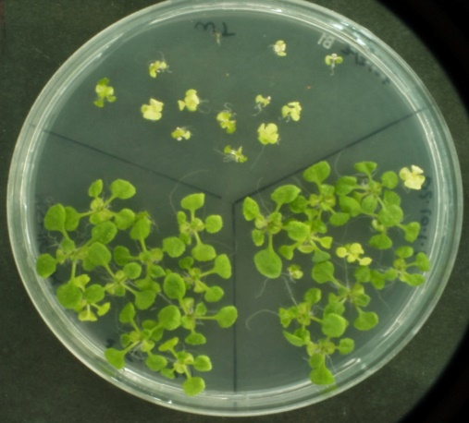

Nickel resistance genes from rhizosphere communities
0 10
-
1
10
-
2
10
-
3
10
-
4
Screening of nickel resistant genes in nickle 2 mM (toxic concentration for the E. coli host)
pSM1
pSM2
pSM3
pSM4
pSM5
pSM6
13 clones with different DNA fragments inserted
pSM7
pSM8
pSM9
pSM10
pSM11
pSM12
Construction of Nickel resistant transgenic plants
pSM13
Wt
Wt
pSKII ⁺
LB-Nickel 2 mM
3rd generation of plants transformed with two genes involved
in metal resistance genes from pSM6 and pSM7 plasmids
(125ug/ml Ni) (18 days)
pSM6
pSM7
Notes:
Drop assay to screen the metagenomic libraries on LB plates containing 2 mM Ni using serial dilutions (0 to 10⁻⁴) from cultures grown overnight. DH5α(pSKII⁺) was used as a negative control
Each assay was performed at least three times using independent cultures.

Slide 19
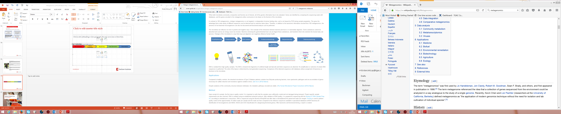
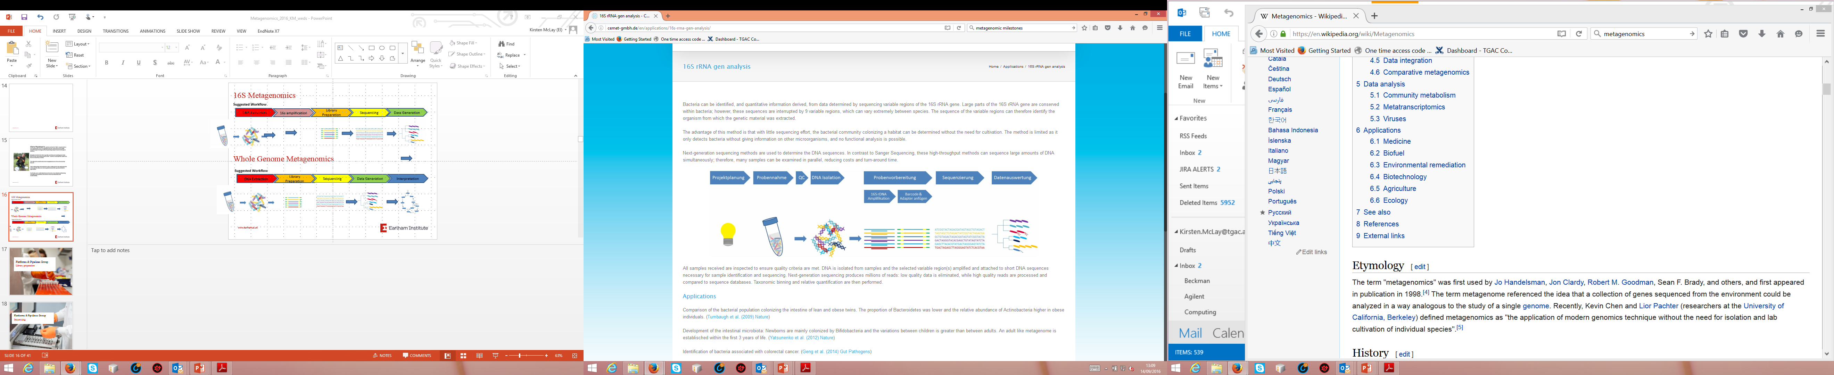
16S Metagenomics*
Bacteria can be identified and quantitative information derived from data determined by sequencing variable regions of the 16S rRNA gene
Large parts of the 16S rRNA gene are conserved within bacteria;
These sequences are interrupted by 9 variable regions, which can vary extremely between species.
The sequence of the variable regions can therefore identify the organism from which the genetic material was extracted.
Suggested Workflow
*Day2 – Dave Baker and Tom Barker
Sample Collection
DNA Extraction
16S Amplification
Library Preparation
Sequencing
Data generation

Slide 20
16S Analysis
The advantage of this method is that with little sequencing effort, the bacterial community colonising a habitat can be determined without the need for cultivation.
The method is limited as it only detects bacteria without giving information on other microorganisms, and no functional analysis is possible.
NGS methods are used to determine the DNA sequences. In contrast to Sanger Sequencing, these high-throughput methods can sequence large amounts of DNA simultaneously; therefore, many samples can be examined in parallel, reducing costs and turn-around time.
After validation of DNA quality, it is prepared for sequencing. Amplification and the attachment of barcode sequences are performed according to published methods (Illumina, Caporaso et al.), and the DNA sequence is typically determined using the Illumina MiSeq sequencing platform.

Slide 21


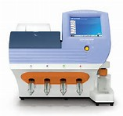
D’Amore et al, BMC Genomics, 2016
In equal abundance
49 bacteria
10 archaeal species
4 technology platforms
Illumina MiSeq
Pacific Biosciences RSII
Roche 454 FLX+
Thermo (Life Tech) Ion Torrent
3 experimental designs
Fusion primers
Universal tailed tag
Ligated adapters

Slide 22
Whole Genome Metagenomics
When both microbiota community composition and function are of interest all of the genetic information has to be evaluated.
Genes are identified by comparing the sequencing reads with databases, and the genes encoded in the metagenome allow conclusions to be drawn on the function of the microbiota.
In addition to the taxonomic information received from 16S metagenomics, the presence of non-bacterial microorganisms can also be discovered and functional analysis can be performed.
After validation of DNA quality, it is prepared for sequencing with the Illumina DNA Sample Prep kit according to manufacturer’s instructions. DNA is sequenced using the Illumina HiSeq2500
Suggested Workflow
Sample Collection
DNA Extraction
Library Preparaton
Sequencing
Data Generation
Interpretation

Slide 23


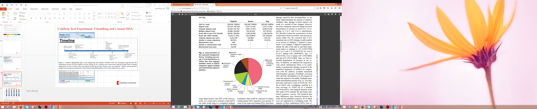
Schuster et al, Science 2005
First NGS Metagenomics study
Emulsion PCR and Roche 454 pyrosequencing
Sequenced 28 million base pairs
45% reads identified as mammoth DNA
98% sequence identity to African elephant
Surprisingly small diversity of environmental samples

Slide 24
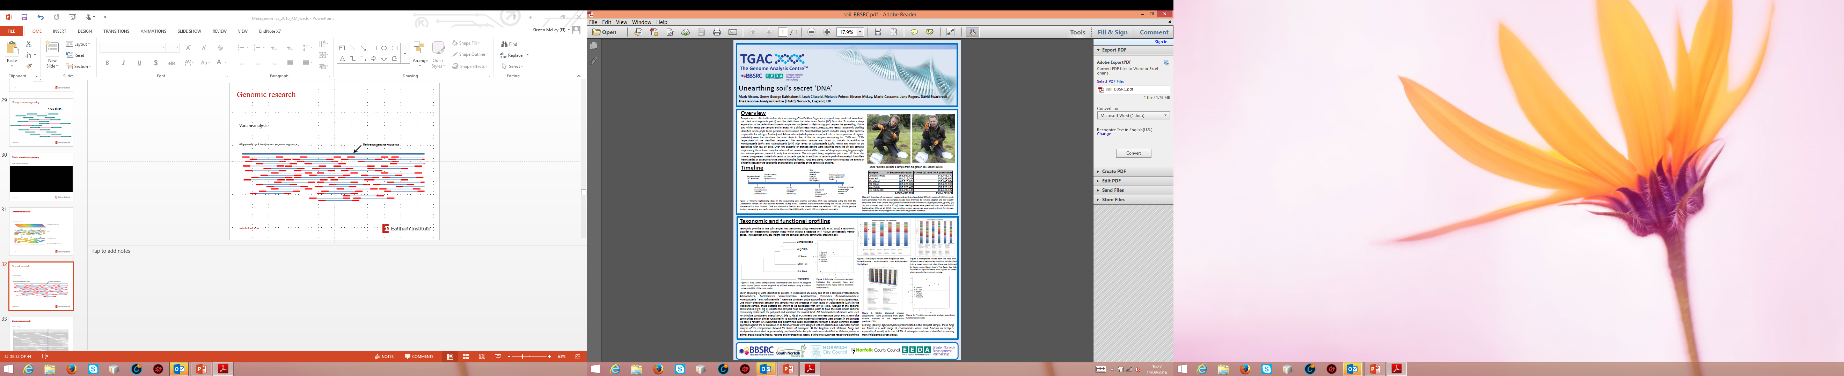
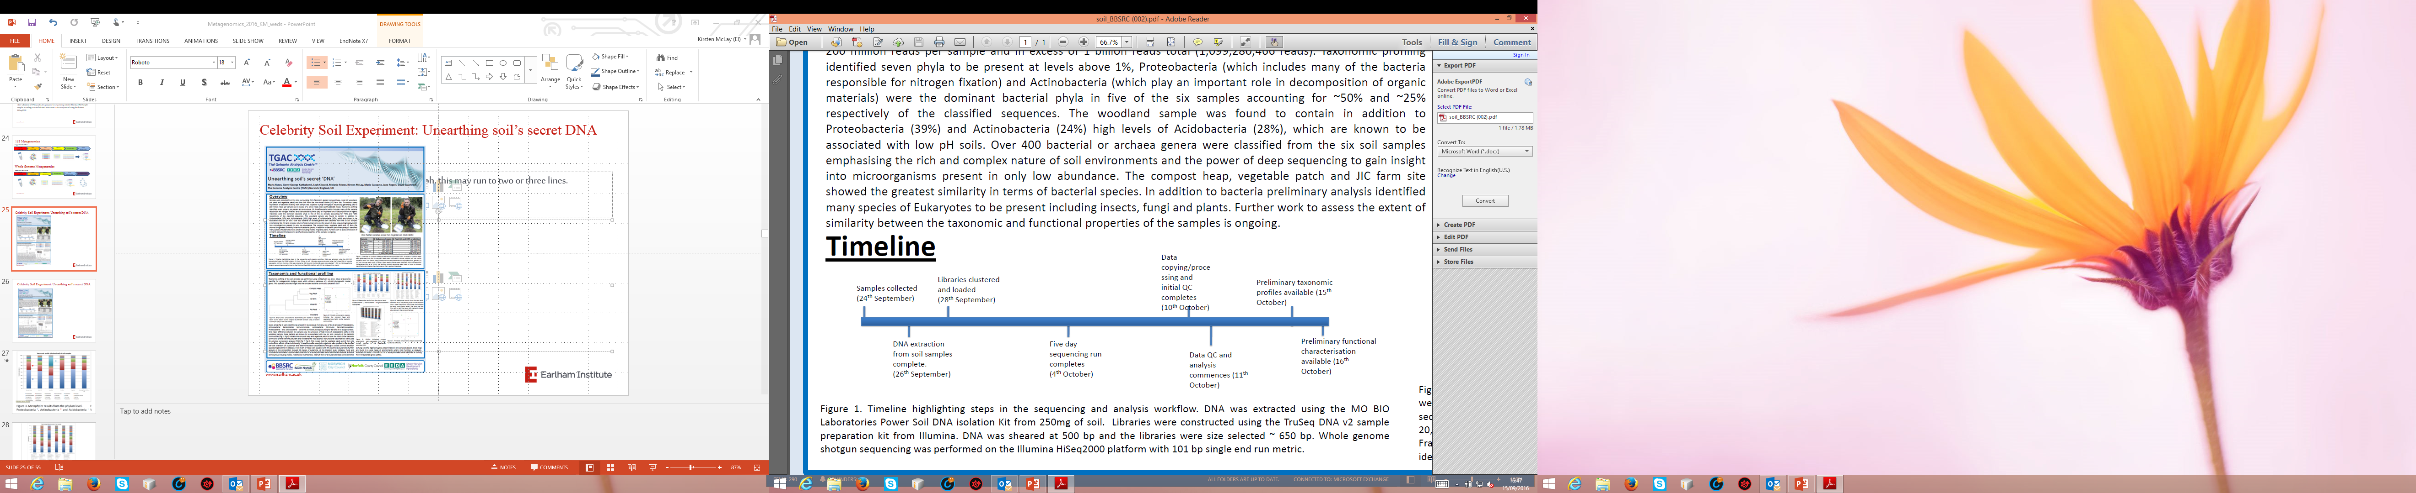
Celebrity Soil Experiment: Unearthing soil’s secret DNA

Slide 25


Slide 26

(Metaphyler. Liu et al, 2011)

Slide 27

Complimentary methods
(Multiple displacement amplification)
Lasken & McLean, Nature Review, 2014

Slide 28
Summary - Metagenomics
One of the fastest advancing fields in biology over the last decade
accelerated with the advent of next-generation sequencing (NGS).
NGS provides researchers the capability to profile entire microbial communities from complex samples
Facilitates the discovery of new organisms
Exploration of the dynamic nature of microbial populations under changing conditions
Extending our understanding of diversity, ecology, evolution, and function
Contribution to the emergence of new applications
Enhances the necessity for technology advancement

